Slide 1
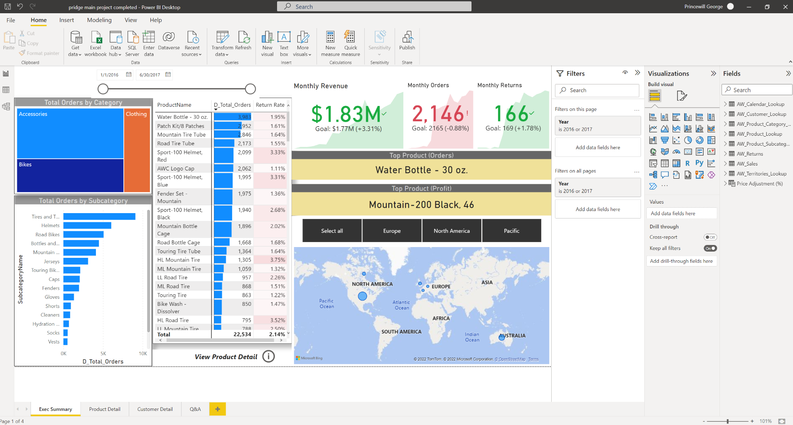
The data used in this report is fake and for demo only.

Slide 2
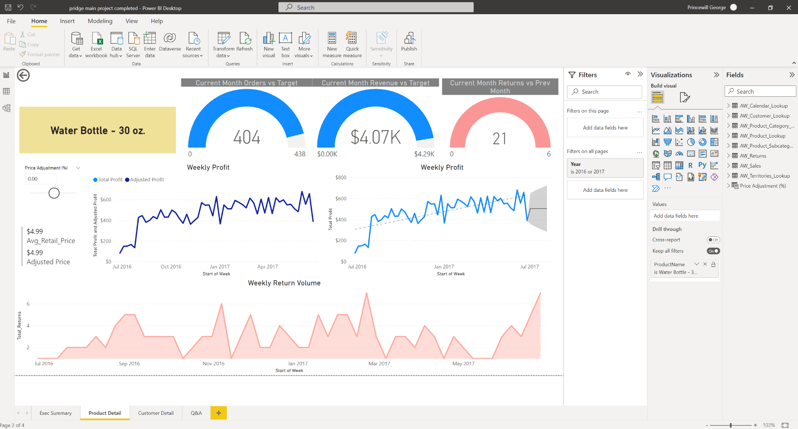
The data used in this report is fake and for demo only.

Slide 3
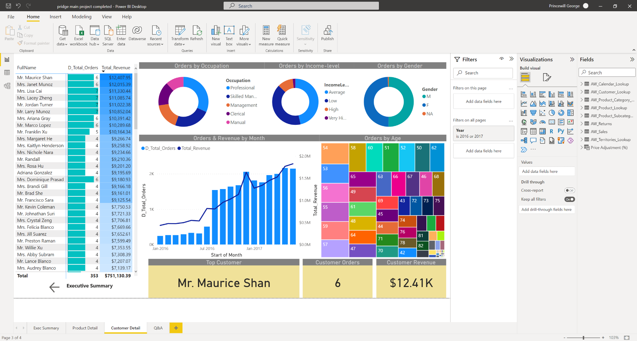
The data used in this report is fake and for demo only.

Slide 4
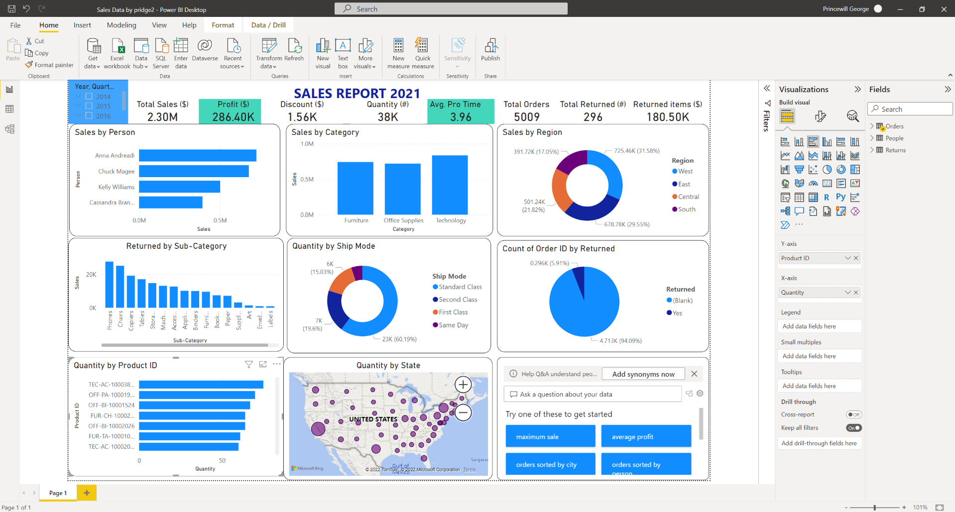
The data used in this report is fake and for demo only.

Slide 5
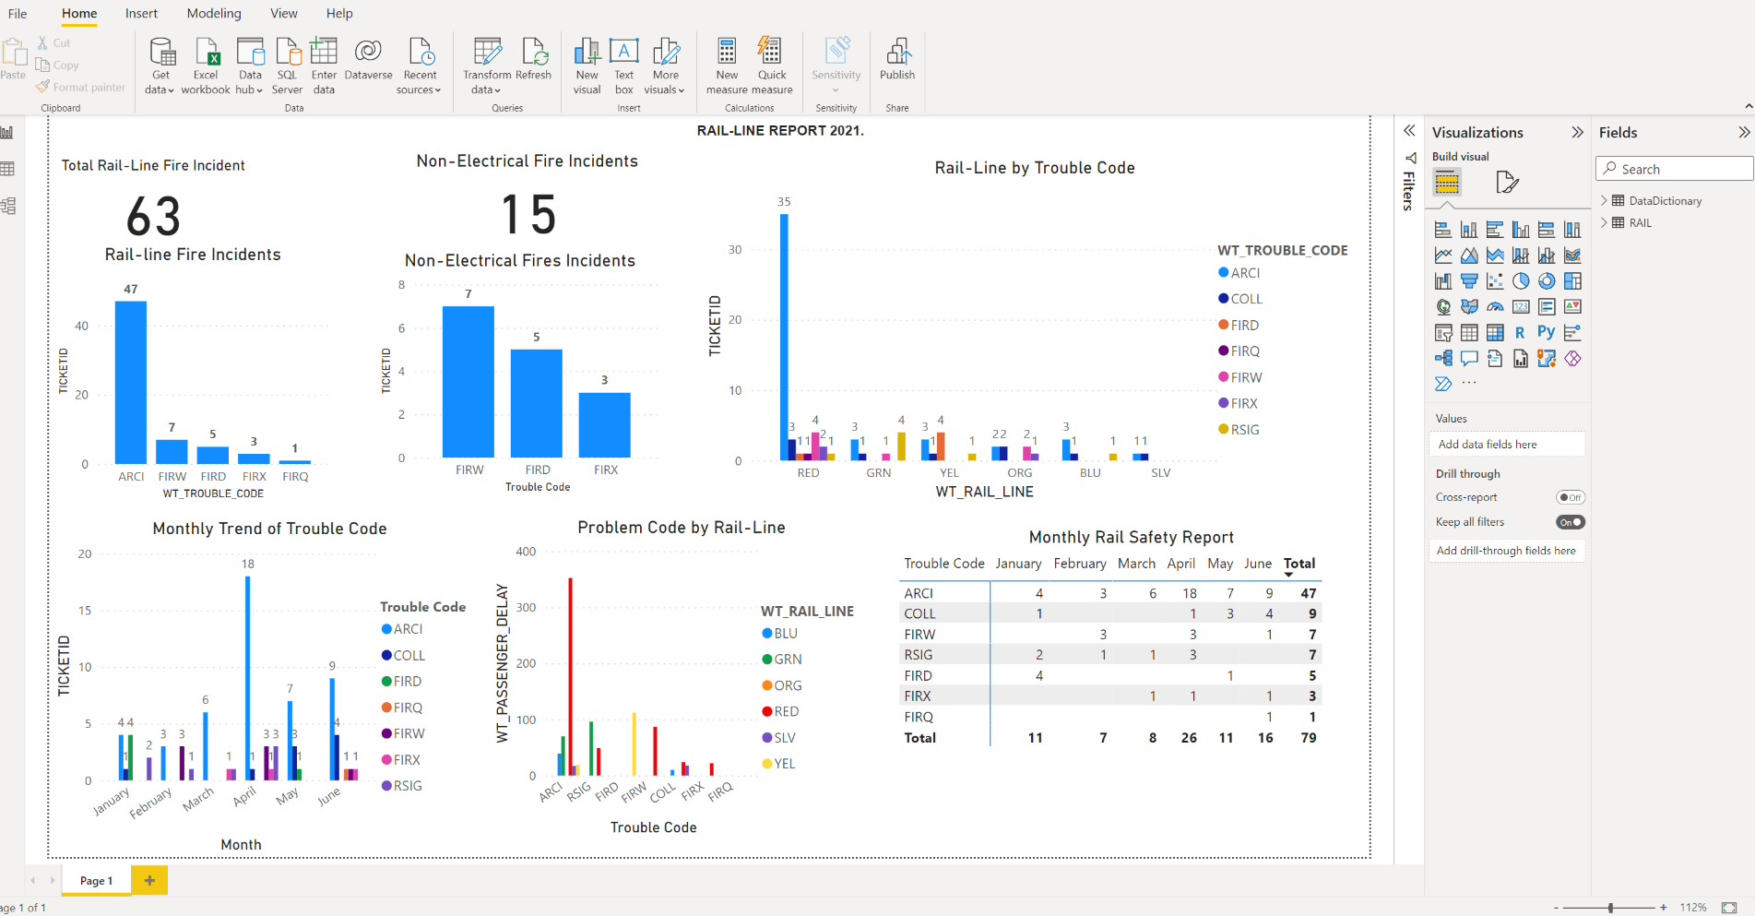
The data used in this report is fake and for demo only.

